Slide 1

Credit Card Default Prediction
Using Data from Credit Card Issuer to Predict Future Defaults

Slide 2
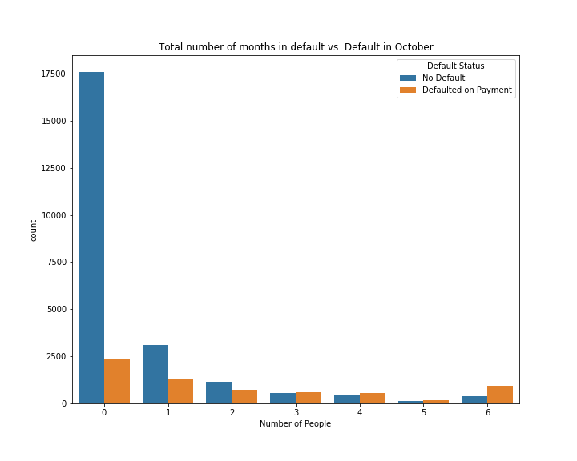
Importance of recognizing risky borrowers
Credit Card losses are currently greater than auto and home loans for lenders.
Four largest US Banks, had nearly 4 billion dollars of bad credit (written off as losses) in the 1st quarter of 2019.
There is a subset of prospective clients who have little credit history. Both Domestically and internationally.
How can lenders capitalize on this group while predicting risk of specific customers and minimizing loss?

Slide 3
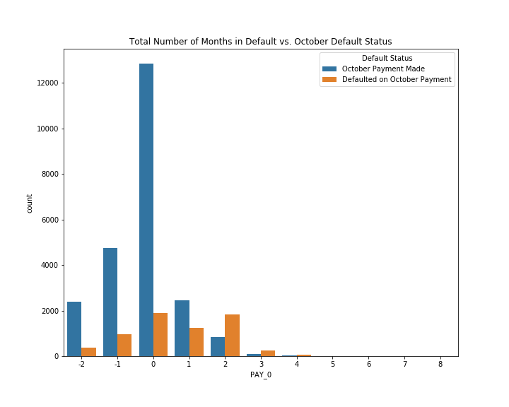
Looking at internal data.
Lenders have opportunity for growth in developing countries. There is less credit information in these parts of world.
Much information can be gained from information outside standard credit info.
Demographic information can be used.
Ongoing credit billing & payment info
Adjacent slide: Most recent billing cycle was most predictive of following month.

Slide 4
Feature Manipulation/ Creation
Machine learning recognizes patterns and relationships between different features
Feature Creation generates new features derived from relationships between existing features.
New features can enable algorithms to better interpret data
Of the six features that had the highest ‘feature importance’ in the Random Forest algorithm, five were produced by feature creation
6 Most Useful Features for Random Forest’s Feature Importance :
1)PAY_O
2)Aggregate_Default_Simple
3) Total_Bill_AMT
4)Total_PAY_AMT
5)Ever_Default
6)Percent_Limit.
*All were made through feature creation besides PAY_0

Slide 5
Machine Learning Algorithms
In choosing the most effective algorithm, trials were done with multiple different algorithms.
Tested algorithms included: KNeighbors, RandomForest, Adaboost, and GradientBoost
RandomForest and GradientBoost were the most effective.
Using precision and recall together was much more useful at measuring model success than accuracy score.
Machine Learning Model | Precision | Recall
Random Forest | .68 | .38
Random Forest predict_proba>= .3 | .54 | .55
AdaBoost | .68 | .33
GradientBoost | .67 | .36
Gradient Boost Predict_proba>=.3 | .57 | .55

Slide 6
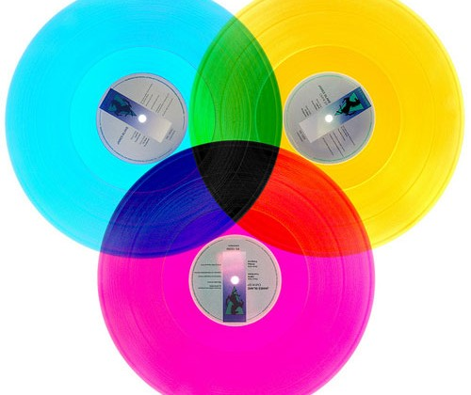
Hyperparameter Tuning
Using Scikit-learn’s Grid SearchCV, the following hyperparameter values were assigned:
Random Forest
Max_depth = 7, max_features = 10, n_estimators = 200
Gradient Boost
Learning_rate = .02, max_depth = 3, n_estimators = 1000,
max_features = .15
* Hyperparameter tuning was only applied to the best performing algorithms

Slide 7
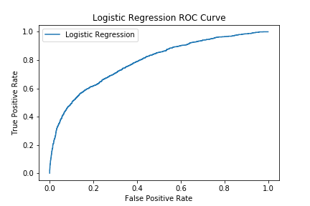
When to classify a borrower as risky?
Algorithms simply predicting whether a consumer’s likelihood of default is above or below 50% may not be most effective.
It is important to look at losses from bad debt vs. profit per compliant borrower to determine optimal intersection of True Positive and False Positive rate.

Slide 8
Choosing a Probability Threshold
Classifying borrowers with a 30% likelihood of default as risky may be more effective than 50%.
Using a 30% threshold for risk, the majority of consumers recognized as risky actually did default (Precision).
At 30% threshold the majority of borrowers labeled at risk actually did default(Recall).
Machine Learning Model | Precision | Recall
Random Forest | .68 | .38
Random Forest probability threshold>= .3 | .54 | .55
Random Forest probability threshold>= .2 | .44 | .66

Slide 9
Why Is Predicting Credit Card Default Important?
Borrowers who do not pay back credit card will be eventually be “charged off” by the lender
Lender will take losses of both the money credited and the interest.
It is essential for lenders to keep the percentage of loans that are charged off to a minimum
Lenders can do this by not issuing credit cards to risky individuals
Credit cards issued to pool of riskier individuals charge higher interest rates to make up for greater percentage of charge offs

Slide 10
Calculations of How Chargebacks Effect Profit Margin
 | Financial Crisis/ Q2 2010 | Current | High Risk Borrowers
Total Loans (USD) | $49,174,397.66 | $49,174,397.66 | $49,174,397.66
Total Loans (New Taiwanese Dollars) | $1,536,699,927.00 | $1,536,699,927.00 | $1,536,699,927.00
Interest Rate | 0.151 | 0.151 | 0.2
Charge Off % | 0.1 | 0.0333 | 0.08
Charge Off expense total | $4,917,439.77 | $1,637,507.44 | $3,933,951.81
Credit Card Interest income | $6,682,800.64 | $7,178,070.42 | $9,048,089.17
Interchange Percent | 0.015 | 0.015 | 0.015
Intercharge total | $737,615.96 | $737,615.96 | $737,615.96
Net Interest Income (USD) | $2,502,976.84 | $6,278,178.95 | $5,851,753.32
Net Interest Income % | 5.09% | 12.77% | 11.90%
Example of how increased charge off rates decrease lender net income & how increasing interest rates for higher risk borrowers compensates for this.

